Slide 1
Discussion questions
In relation to the R exercise
How does the R₀ for SARS-CoV-2 compare to that of other pathogens? Is your estimate of R₀ consistent with that of other estimates? If yes, why might there be any discrepancies?
How do you interpret the HIT you obtained though your calculation? Do you think this is an overestimation or an underestimation? Justify your response.
How do the IFRs compare between COVID-19 and the flu?
Do you think the death toll associated with natural herd immunity is justifiable? Do you think it is an overestimate or an underestimate? Do you see potential alternatives to the natural herd immunity approach?

Slide 2
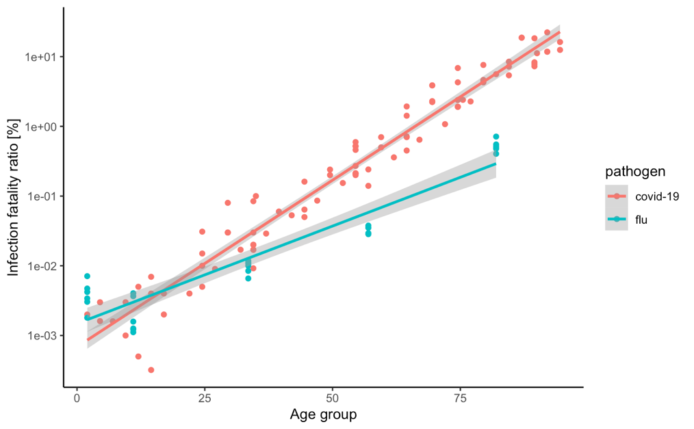
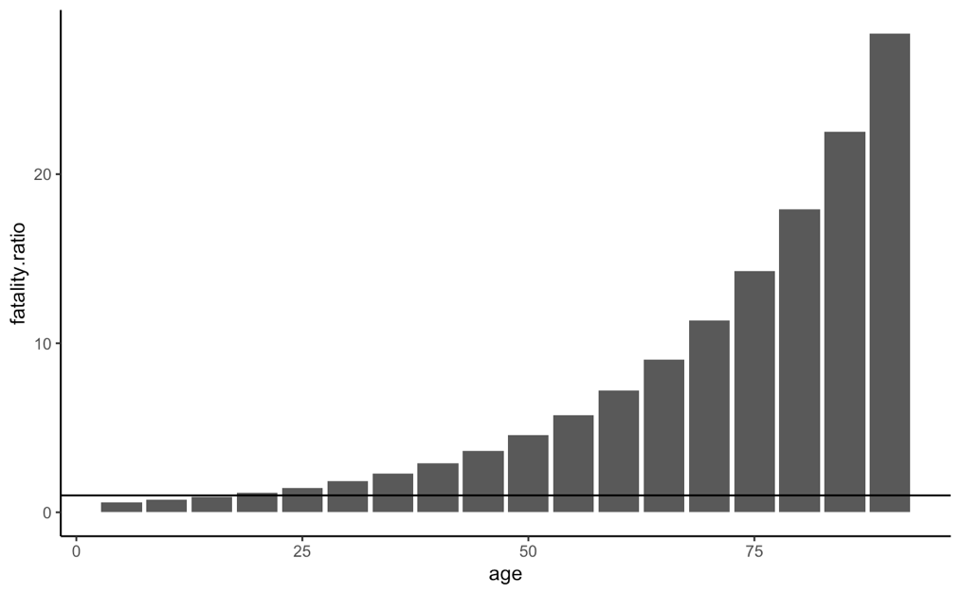
An epidemiological perspective in COVID-19
R₀: ~3.8
HIT: ~0.75
RIP: 0.7 % of population at 1.8 % IFR
How does the R₀ for SARS-CoV-2 compare to that of other pathogens?
How do you interpret the HIT you obtained though your calculation? Do you think this is an overestimation or an underestimation?
How do the IFRs compare between COVID-19 and the flu?
Do you think the death toll associated with natural herd immunity is justifiable? Do you think it is an overestimate or an underestimate?

Slide 3
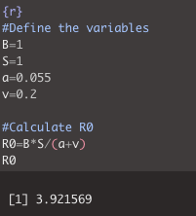
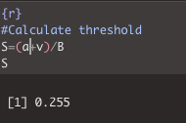
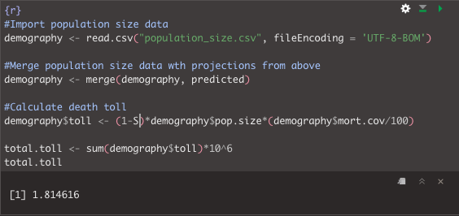
R₀
HIT
Death toll

Slide 4
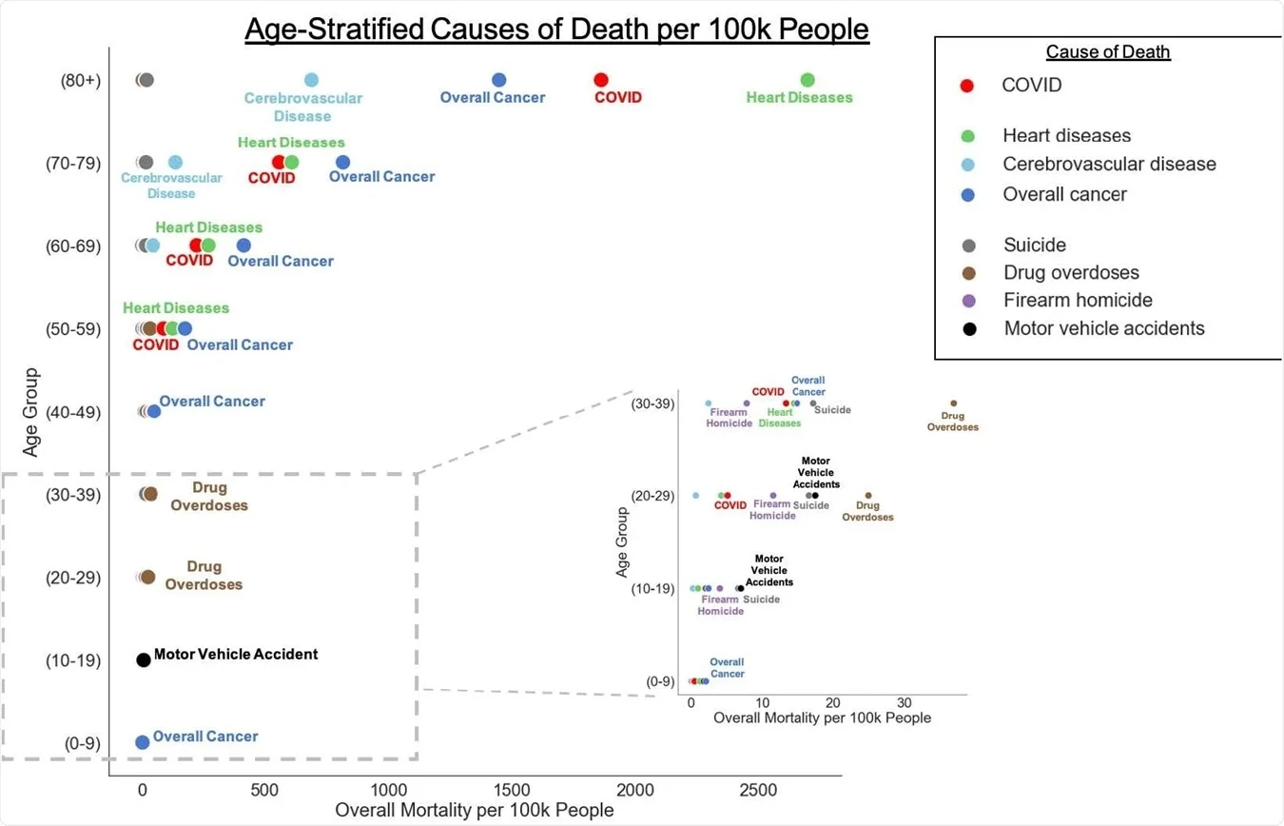
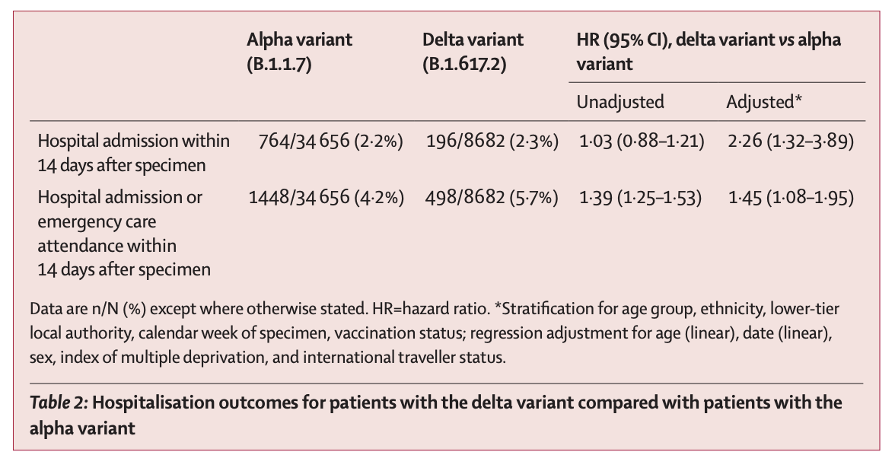

Slide 5
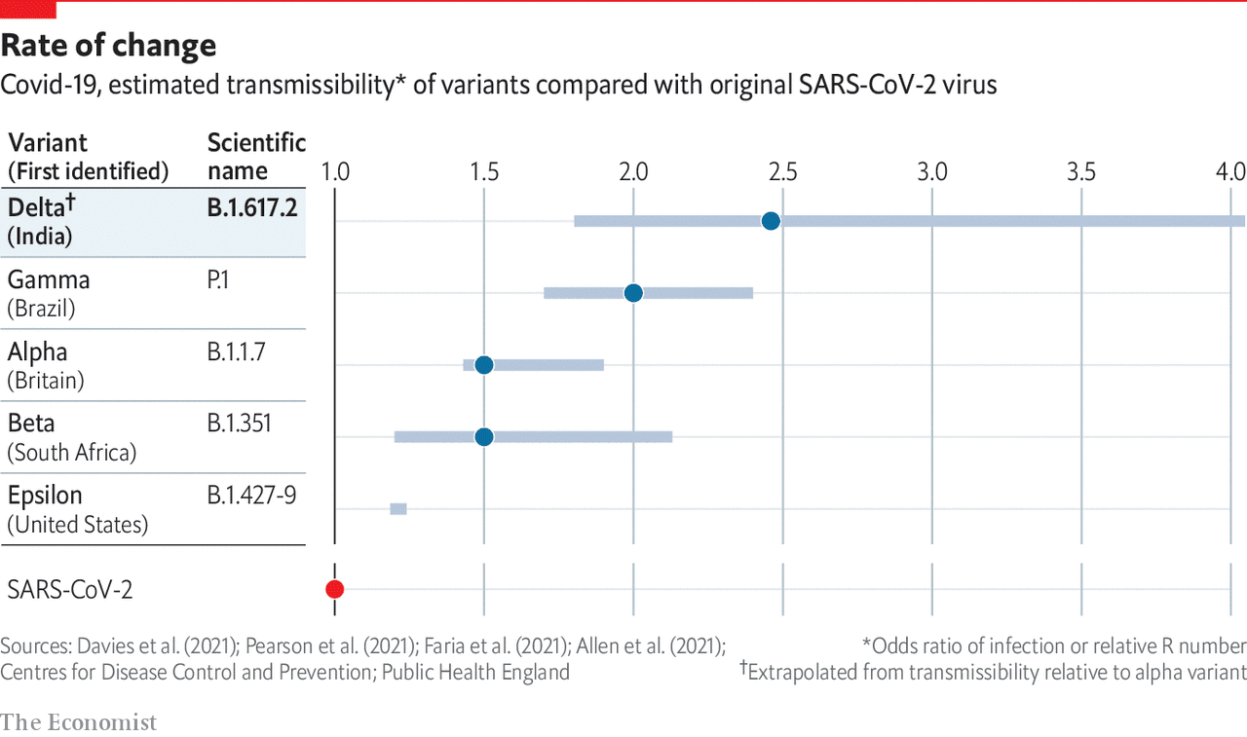
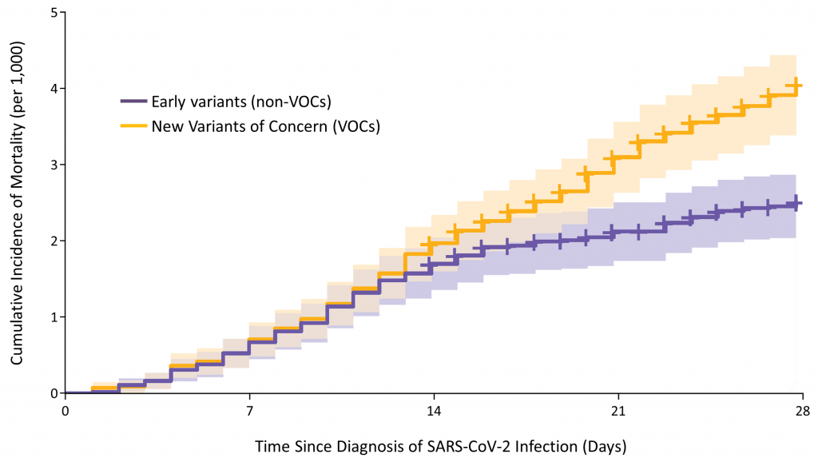

Slide 6
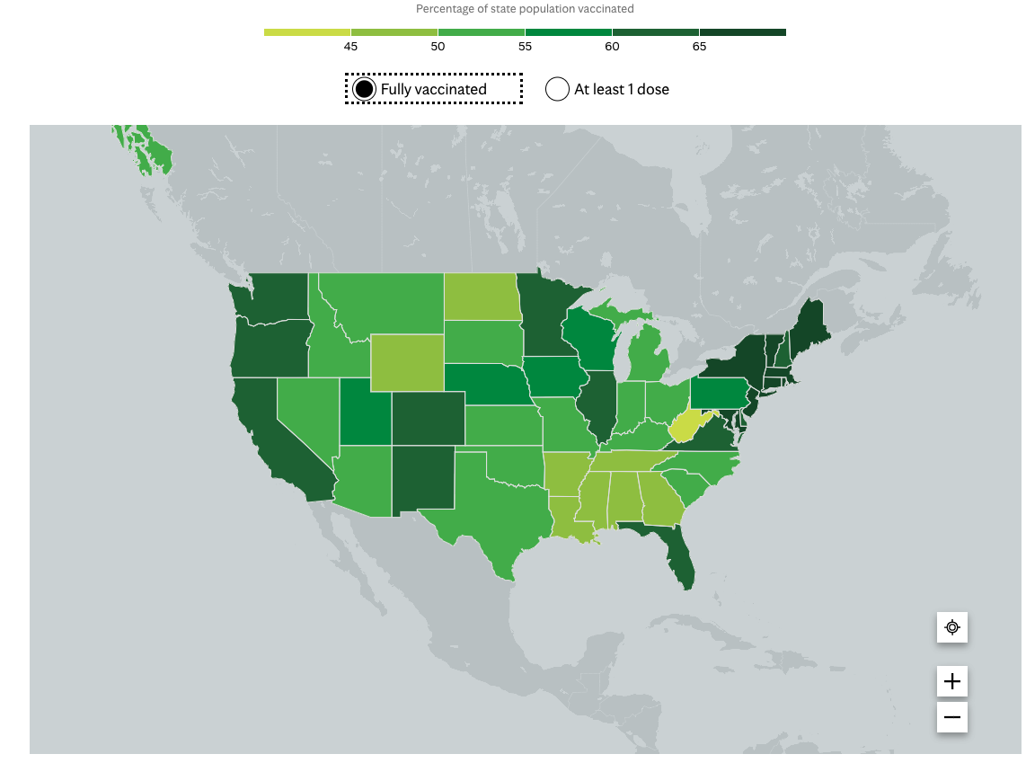
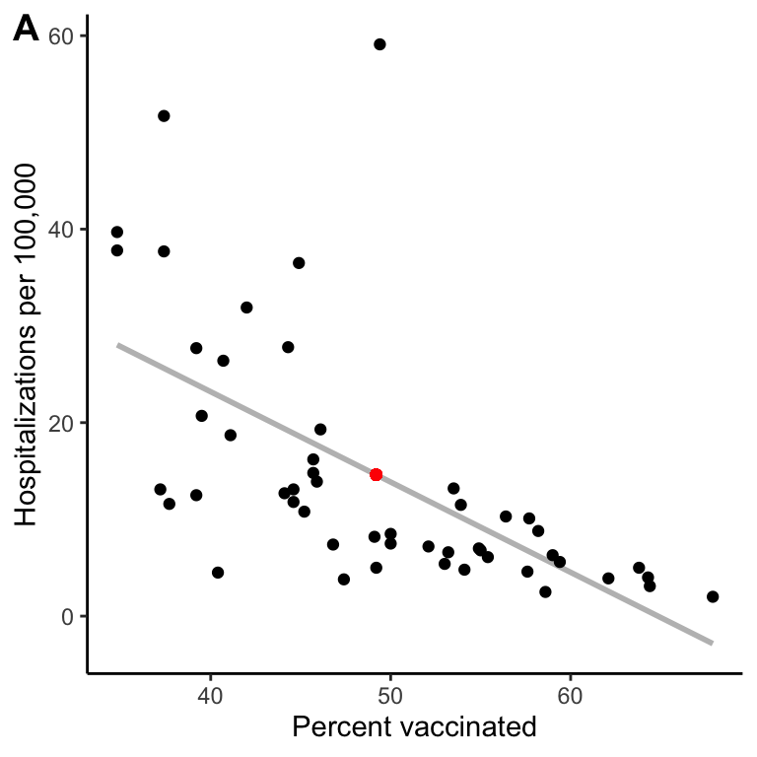
Top: 73% (Vermont)
Bottom: 42% (West Virginia)
Kansas: 55%

Slide 7
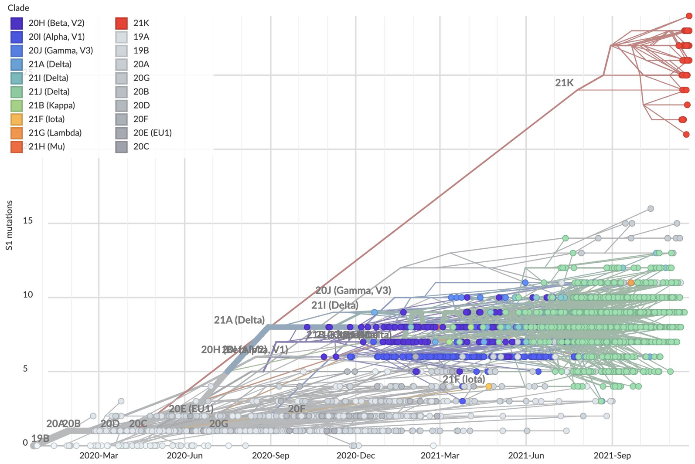
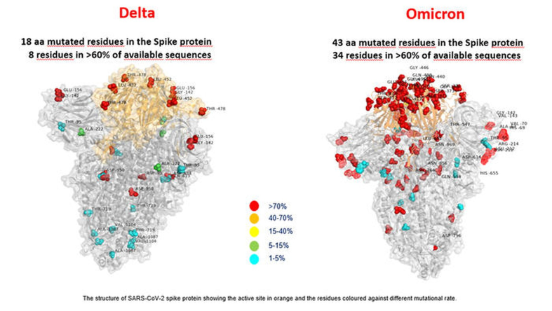

Slide 8
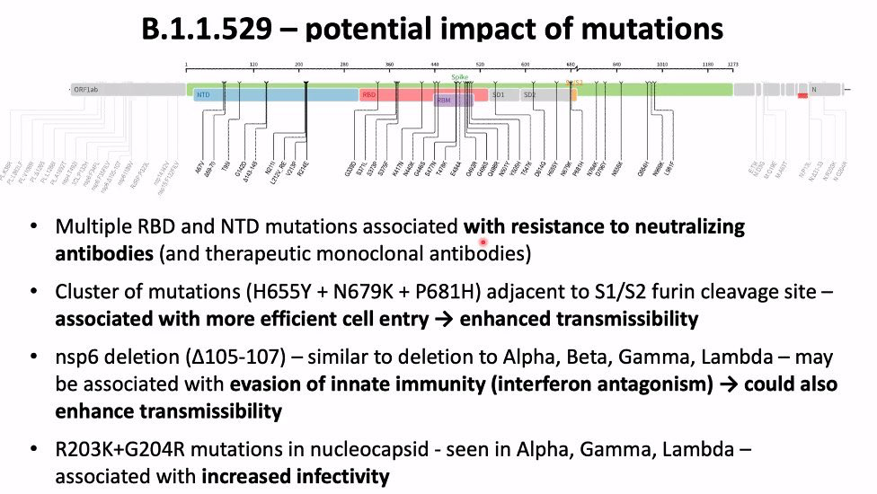

Slide 9
What doesn’t kill you
makes you stronger
mutates and tries again

Slide 10
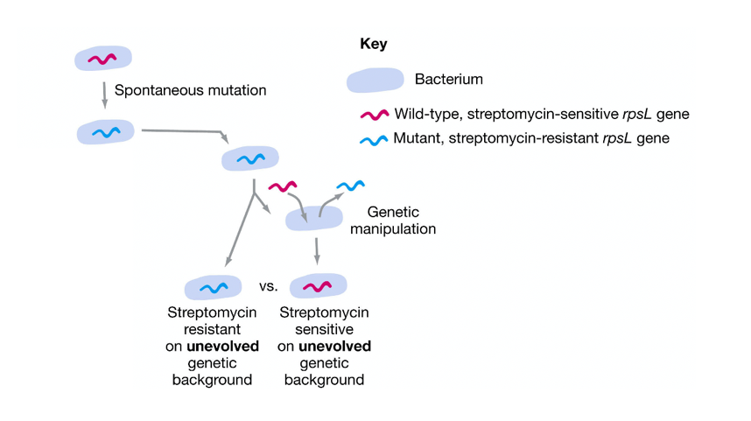
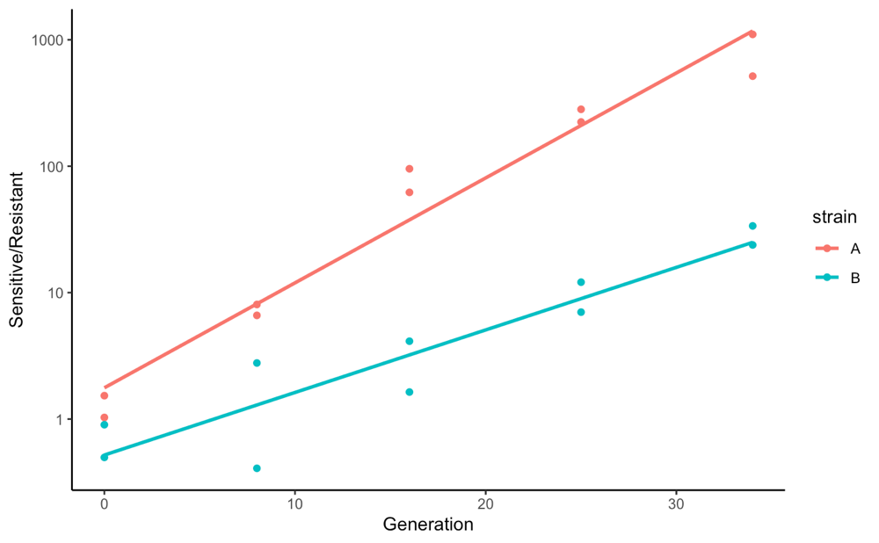
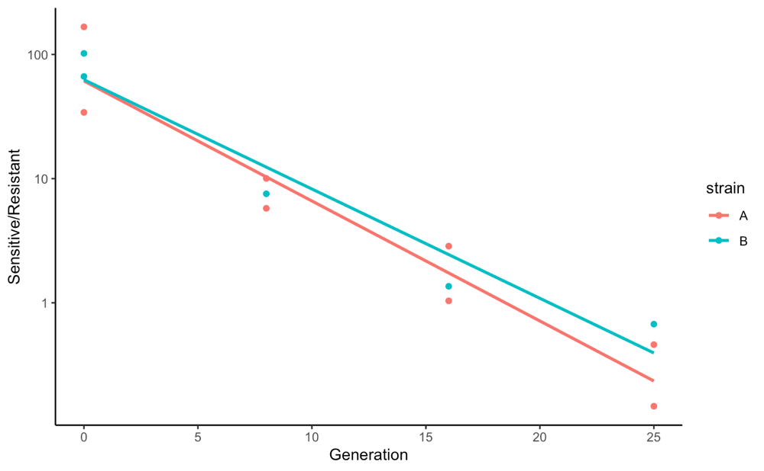
Antibiotic resistance
What are the implications of these findings for the application of antibiotics in public health? What specific recommendations would you make to health care professionals based on this experiment?

Slide 11
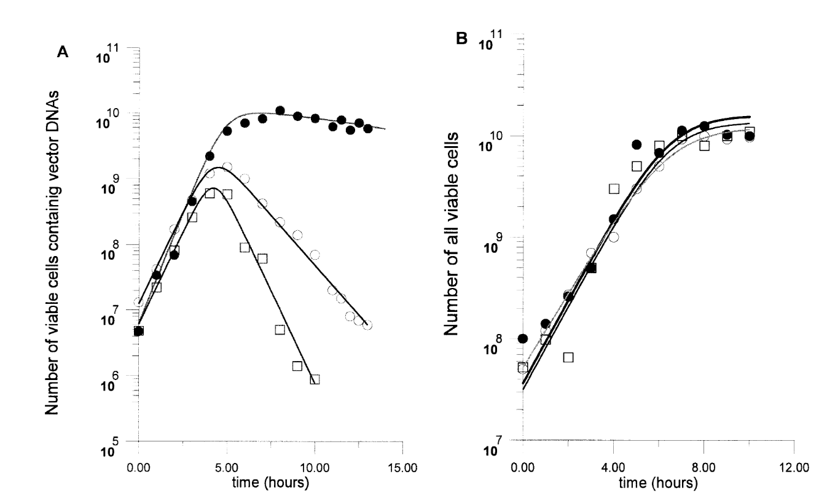
Antibiotic resistance
What are the implications of these findings for the application of antibiotics in public health? What specific recommendations would you make to health care professionals based on this experiment?
With antibiotic
Without antibiotic
6 kB
11.8 kB
15.5 kB
Notes:
g

Slide 12
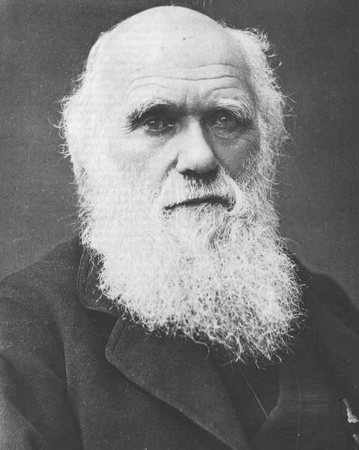
Evolution & human health
“Man still bears in his bodily frame the indelible stamp of his lowly origin.”
C. Darwin

